Slide 1
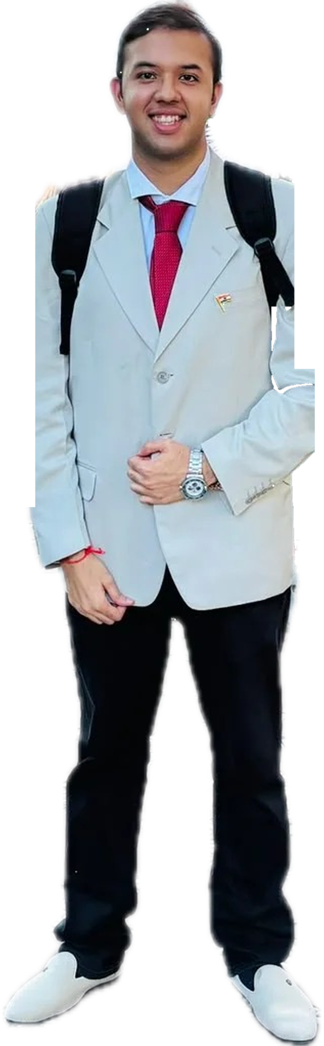
26
GRID ENTRY · PLACEMENT COMMITTEE 2026
SUTEEKSHN
MAHAJAN
MBA (International Business) 2026–28, IIFT Kolkata. Corporate Support Committee member.
Ex–Marketing Head, Team Knox, IIT Roorkee.
This is my driver card. Six strengths, one lap, zero fluff.
94
+81
400+
OVERALL
POSITIONS
STUDENTS
Notes:
Opening. I'm Suteekshn, MBA IB 2026-28. I'm standing for the Placement Committee. Rather than a list of claims, I've built this as a driver card: every rating on the next slides has a number behind it.

Slide 2
I have already done the job without the title
THE ONE-LINE PITCH
01
Inside the placement process already
Corporate Support Committee, IIFT Kolkata — 100+ avenues of recruiter interaction, the Summer Internship Process 2026, and internal coordination for 400+ students. I have conducted GDs and reviewed CVs for this batch.
02
A team that climbed 81 places
Marketing Head of Team Knox, IIT Roorkee. I built the marketing vertical from nothing and took the team from Rank 84 to Rank 7 amongst 150+ teams — then repeated it the following year.
03
The data work nobody has to ask for
A live F1 analytics platform with Monte Carlo race simulations, a world news tracker, dashboards — all built with Claude Code. If the committee needs a tracker, it exists the same week.
Notes:
Three things I bring: exposure to the process, a track record of lifting a team, and the data skills to run placements on numbers instead of guesswork.

Slide 3
The attribute sheet
SECTION 01 — DRIVER RATING
AI & DATA CRAFT
94
94
F1 analytics platform, Monte Carlo sims, live news tracker
TEAM BUILDING
96
Built a marketing vertical from zero inside Team Knox
PLACEMENT OPS IQ
92
OVERALL
TIER · LEGENDARY
100+ recruiter avenues, SIP 2026, 400+ students
CONSISTENCY
95
95.0% · 92.8% · 91.40% / 8.635 CGPA, four roles at once
Every rating is backed by
something that happened.
MARKETING & OUTREACH
93
7,000+ community at HIPPOS, 2,000 LinkedIn for Team Knox
PRESSURE MANAGEMENT
91
Rank 58 of 5,276 at the Bajaj Finserv Atom CEO Challenge
Notes:
Six attributes. The bars are the claim; the line under each is the evidence. Overall 94 — the weakest is pressure management at 91, and even that has a national ranking behind it.

Slide 4
Six cards, six strengths
SECTION 02
The front is the claim. The back is the receipt.
Notes:
Six cards. Two legendary, three epic, one rare — same grammar as an F1 game driver card.

Slide 5
What I build, and what I build with people
SECTION 02 — THE DECK · 1 OF 2
LEGENDARY
94
LEGENDARY
96
EPIC
95
RATING
RATING
RATING
94
96
95
VIBE CODE
TEAM ARCHITECT
PODIUM MAKER
AI & DATA · SPECIAL ABILITY
LEADERSHIP · BUILD FROM ZERO
MENTORSHIP · LEGACY
Built a live F1 analytics platform with Claude Code — race strategy, performance and driver insights.
Monte Carlo simulations for outcome modelling, plus a world news tracker on an interactive map.
Marketing Head, Team Knox, IIT Roorkee. There was no marketing vertical — I built it.
Rank 84 to the Top 10 amongst 150+ teams, and Rank 7 twice over — 2021 and 2022.
After graduating I kept mentoring the junior Team Knox squad through the handover.
They took 3rd in Cost Evaluation at BAJA SAE India 2023 — with me off the roster.
LIVE PRODUCTS SHIPPED WITH AI
P84 → P7 POSITIONS CLIMBED
P3 WITHOUT ME IN THE CAR
Notes:
Vibe Code: I ship the data work myself. Team Architect: 81 places, twice over. Podium Maker: the result came after I left — that is what a committee seat should leave behind.

Slide 6
What I hold steady, and who I hold it for
SECTION 02 — THE DECK · 2 OF 2
EPIC
95
EPIC
92
RARE
93
RATING
RATING
RATING
95
92
93
CONSISTENCY ENGINE
RECRUITER RADAR
PIT WALL COMMS
ACADEMICS UNDER LOAD
PLACEMENT OPERATIONS
OUTREACH & COMMUNITY
95.00% in Class X, 92.80% in Class XII, and 91.40% / 8.635 CGPA at IIT Roorkee.
First Division with Distinction — while running marketing, a subsystem and a tutoring programme.
Corporate Support Committee, IIFT Kolkata — 100+ avenues of recruiter interaction executed.
Bridged the Placement Committee and the MBA-IB batch through the Summer Internship Process 2026.
Founded HIPPOS — 7,000+ followers, 10+ writers and a weekly policy newsletter.
Took Team Knox to 2,000 LinkedIn followers; tutored 50+ juniors under IIT Roorkee's ARP.
90%+ ACROSS X, XII AND UG
100+ RECRUITER AVENUES
7,000+ COMMUNITY BUILT
Notes:
Consistency under load, the recruiter-side view from the CSC, and the comms work — 7,000 people who follow something I built because it is useful.

Slide 7
P84 → P7 → P3
SECTION 03 — RACE TRACE
+81
POSITIONS GAINED
Team Knox entered the Sales Evaluation event at Rank 84. I built the marketing function around it and we finished Rank 7 — then did it again the next year, so nobody could call it luck.
After I graduated, the junior team I mentored took 3rd place in Cost Evaluation at BAJA SAE India 2023.
Notes:
BAJA SAE India, a national field of 150+ teams. Note the axis is logarithmic — the jump from 84 to 7 is the big one, but holding 7 and then taking the junior team to 3 is the part that says it was systematic.

Slide 8
Why the PlaceCom seat
SECTION 04 — SECTOR TIMES
S1
PERSONAL BEST
S2
FASTEST
S3
PERSONAL BEST
27.4
31.9
24.8
EXPOSURE
EXECUTION
EMPATHY
On the Corporate Support Committee I sat inside the Summer Internship Process 2026 — conducting GDs, reviewing CVs, bridging the Placement Committee and the MBA-IB batch. I have watched ICICI Bank, Accel, Philips and D. E. Shaw run a process from the floor, not from a recap email.
Rank 84 to Rank 7, twice. 100+ recruiter interaction avenues executed. Two internships shipped — a 7-supplier sourcing plan at >95% QC, and a full-funnel GTM that hit 48% GM/SKU at a CAC of ₹285. I close loops and document them.
400+ students, each with a different profile and a different fear. I have assisted batchmates on CVs and mock GDs, tutored 50+ juniors, and run a 7,000-person community where the only currency is being useful. Placements are a people problem first.
Notes:
Three sectors. Exposure — I already know the process. Execution — I finish things. Empathy — the 200th person on the shortlist is the one who needs the committee most.

Slide 9
The lap so far
SECTION 05 — CIRCUIT MAP
S/F
T1
T2
T3
T4
2018
2019
2020
2021
2022
IIT Roorkee — B.Tech begins
Best Aesthetics, Srishti’19
Team Knox — Suspension Engineer
Rank 7 national — BAJA SAE
Marketing Head — Rank 7 again
T5
T6
T7
T8
T9
2022
2023
2025
2026
2026
Graduated — 8.635 CGPA
Mentored team → 3rd place
Soul Mirage — GTM & sourcing
Escorts Kubota — Mgmt Trainee
IIFT Kolkata — CSC member
Notes:
Ten corners, 2018 to today. The through-line is that every role was one I built or lifted rather than inherited.

Slide 10
Give me the seat
CHEQUERED FLAG
I have already done the job without the title — inside the Corporate Support Committee, inside a team that climbed 81 places, inside a community of 7,000.
Put me on the Placement Committee and I will bring the same three things: the data to see the grid clearly, the discipline to run the process, and the patience to sit with the person who is 200th on the shortlist.
+81
400+
100+
7,000+
90%+
POSITIONS GAINED
STUDENTS SUPPORTED
RECRUITER AVENUES
COMMUNITY BUILT
X · XII · UG
LIGHTS OUT — LET'S GO
Full driver card: suteekshn-mahajan-profile.vercel.app
Notes:
The ask. And the live version of this driver card is online — the URL is on the slide.

